Slide 1
Find Your Voice
Welcome to [Insert Club Name Here]!

Slide 2
What is Toastmasters?
A worldwide nonprofit educational organization empowering people to become more effective speakers and leaders
A network of over 352,000 memberships in more than 16,400 club in 141 countries
The largest provider of dynamic, high-value, experiential communication and leadership skills development in the world

Slide 3

Toastmasters Mission
We empower individuals to become more effective communicators and leaders.

Slide 4
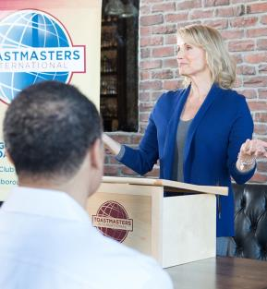
The Club Mission
Clubs provide a supportive and positive learning environment that empowers members to grow, resulting in greater self-confidence and personal achievement.

Slide 5
What You’ll Experience in a Club
Self-paced, hands-on learning environment
Regular opportunities to speak:
  Ice Breaker speech
  Table Topics
  Prepared speeches
Honest and encouraging peer evaluations
Volunteer leadership opportunities
Access to a mentor
Did You Know? Thousands of people around the world attend Toastmasters meetings every day to become more confident speakers and leaders in their communities and organizations!

Slide 6
What’s in it for You?
A supportive and positive learning experience
Develop communication and leadership skills
Greater self-confidence and personal growth.
Competitive advantage in the workplace
Join a global organization with a dedicated World Headquarters team
Participate in speech contests
Become an Accredited Speaker

Slide 7
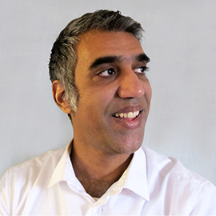
Toastmasters also offers:
District conferences
An annual convention in August
Access to helpful resources
Subscription to the Toastmaster magazine
“Since joining Toastmasters, I’ve grown as a communicator and leader by taking more chances in work and life.”
Shahid Quadri, ACB, CL
Web designer, Speaking Coach

Slide 8
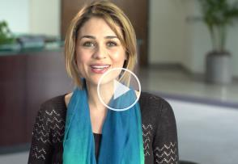
What Members are Saying
“I got myself back. I got confidence back.”
Sara Safari, DTM
Watch Sara tell her story

Slide 9
Our Club: Member Testimonial
(This is an opportunity for one of your club members to give their own testimonial)
[Member Name]
[How long in Toastmasters?]
[Any leadership roles held?]
[Recognition status]
Notes:
Optional: Add your own member testimonial and have them talk about their experience during the presentation or the presenter can speak to the slide.

Slide 10
Membership Cost
US dues are $45 every six months
International dues are $33.75 every six months
Note: Some clubs may charge additional fees
New members pay a one-time fee of $25

Slide 11
How to Join
Speak with our VP of membership, [Name of VP]
Complete a membership application
Return completed application with your dues to the VP of membership
Additional Questions about Toastmasters International – check out www.toastmasters.org

Slide 12
Thank You for Attending!
[Insert Club Photo Here]

