Slide 1
Club Visit Strategies
Presented By
Jim Kearney
Jim_Kearney @ Hotmail.com
818-636-5547
Notes:
You are not in this alone
Support is close at hand. Their fellow district leaders, region advisers, and the district services team at world headquarters are all available and eager to assist them.
Area Director is THE most important role at the district level because it’s a direct link to the clubs
The area director is the person at the district level who is most involved with the clubs
He or she as their hand on the pulse of the clubs
Area director has no direct authority to do anything at the club level
The role of the area director is to support the clubs to give the club members the best possible experience.

Slide 2
Agenda
What is a Successful Club Visit?
Club Visit Outcomes
Q & A
Club Visit Strategies

Slide 3
Identify
Recognize
Develop
Identify what a successful club visit looks like
Recognize club visit outcomes
Develop strategies to hold productive and successful club visits

Slide 4
What is a Successful Club Visit?
Notes:
Club visits are your most impactful tool in supporting and influencing clubs throughout your term. In this section, we will be defining what is a successful club visit.
This will assist in your club visit preparation.

Slide 5
What should you review prior to your club visit
Preparation is key to a successful club visit
1. Area Directors Dashboard
2. Moments of Truth
3. DCP Dashboard
4. Area Director Club Visit Report
5. Club Success Plan
6. Questions to consider

Slide 6
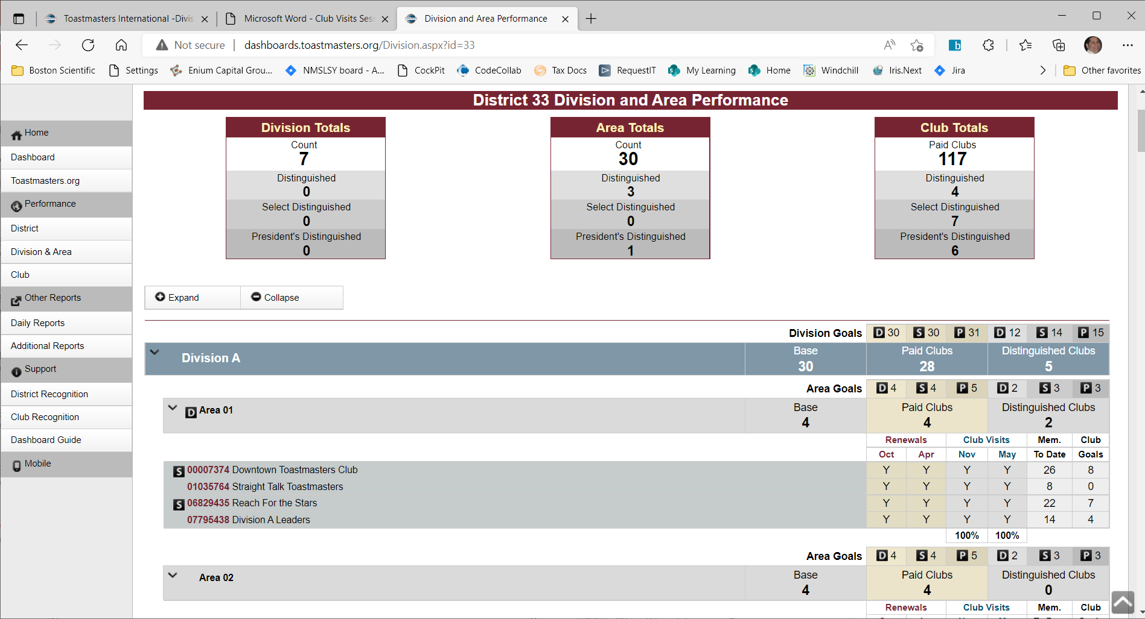
Area Directors Dashboard
Division and Area Performance (toastmasters.org)
http://dashboards.toastmasters.org/Division.aspx?id=33
Notes:
Division Area Performance Dashboard gives you and overview of the Division Status broken down by Areas
You can see at a glance the renewals, club visit, member to date and club goals
This paint for you and overall idea of how your Area is doing
N’s and low numbers indicate issues that should be addressed
N for renewals means you should probably be talking to the officers and finding out why people are not renewing
12 or less members means the club is eligible for a coach – find out if they want one

Slide 7
Moments of Truth
Moments of Truth
Notes:
When anyone comes in contact with any aspect of Toastmasters, the person forms an impression based on his or her experience at that particular time. Clubs must remain cognizant of these crucial, decisive times and ensure that every experience with Toastmasters is a positive one. There are six critical moments of truth in which clubs have an opportunity to create positive impressions.
The six critical Toastmasters moments of truth are:
First Impressions
Membership Orientation
Fellowship, Variety, and Communication
Program Planning and Meeting Organization
Membership Strength
Achievement Recognition
Have the club officers deliver their moments of truth presentations early in the year

Slide 8
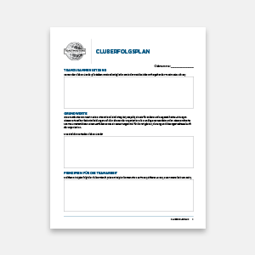
Club Success Plan
Club Success Plan
Notes:
Club Success Plan
There are multiple ways of clubs doing things – in D33 there is a simplified spreadsheet that covers everything in the success plan
The success plan is a road map for the club to follow in order to be successful and reach all goals
You should encourage clubs to build one and upload it in club central
Assist the clubs to establish their DCP goal and use the plan to achieve that goal
Get them to understand the benefits of the plan, establish their plan and upload it to club central

Slide 9
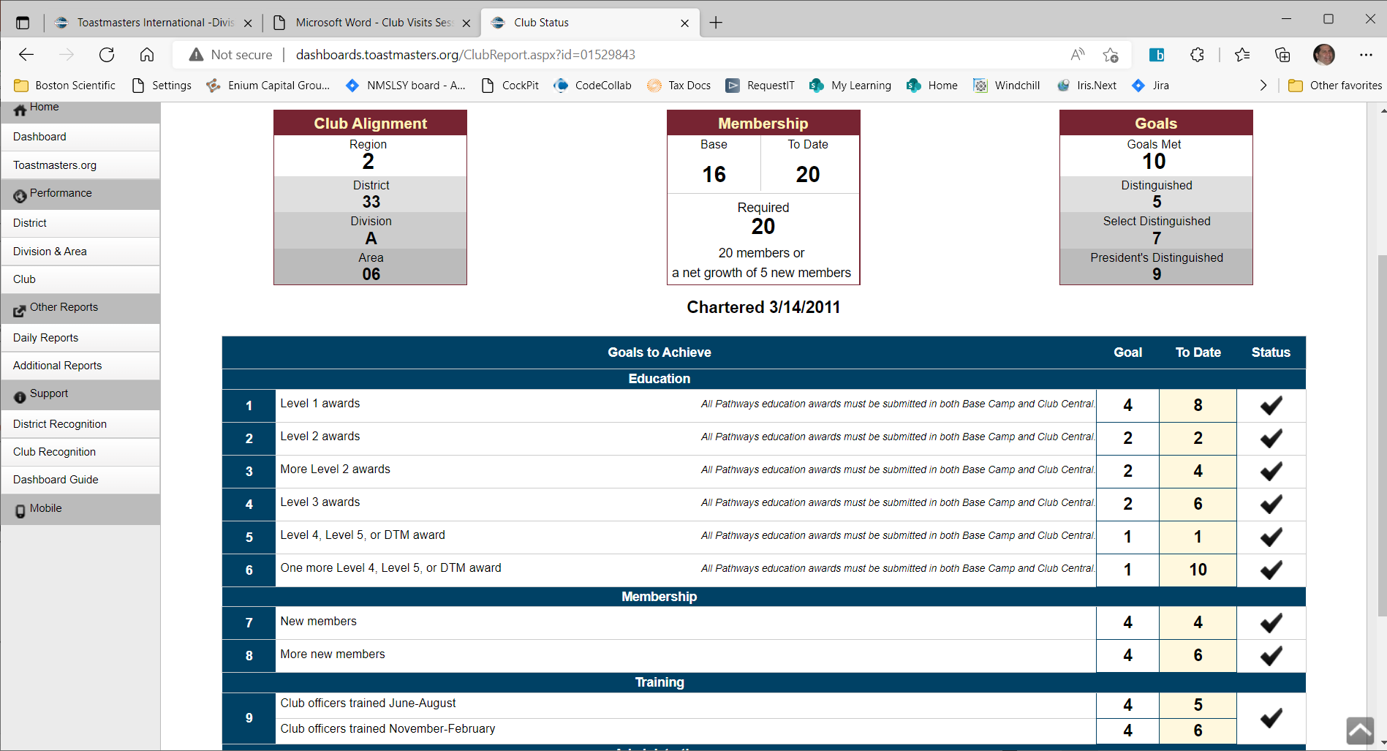
DCP Dashboard
Notes:
Club dashboard tells you two main things on the DCP trail
Membership Status
Goal Status
You need to meet BOTH membership and Goals to become Distinguished or better
Membership tells you the base, what is required and how many you have to date
Have all clubs shoot for 20 (District goal this year)
Goals 5 for Distinguished, 7 for Select Distinguished and 9 for Presidents Distinguished
Have all clubs shoot for President

Slide 10
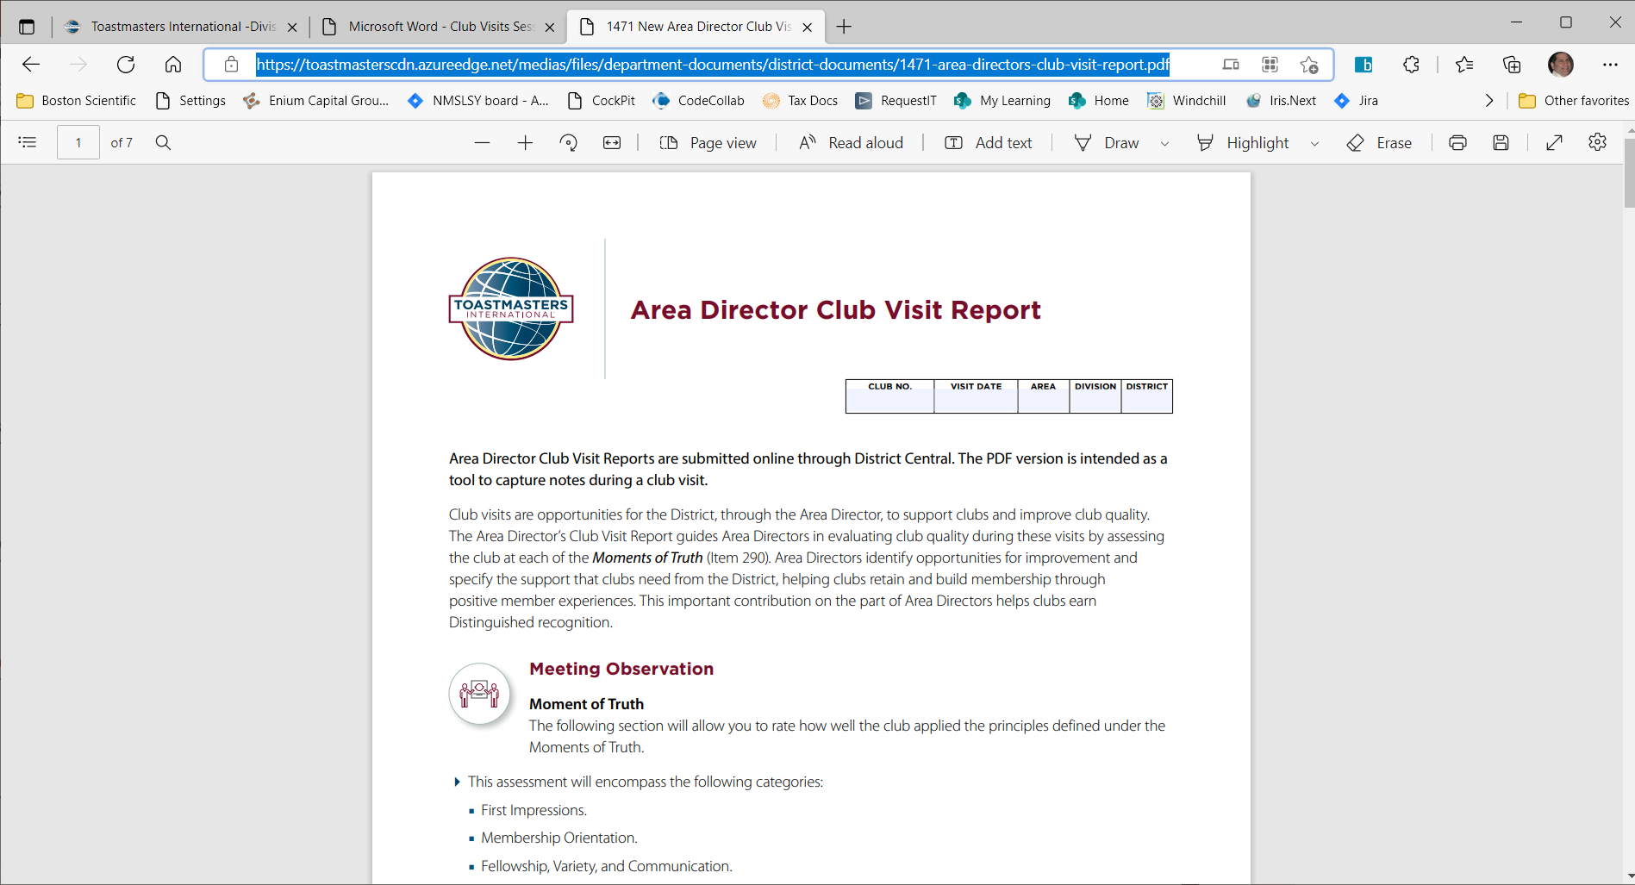
Area Director Club Visit Report
Area Director Club Visit Report
Notes:
Area Directors Club Visit Report
You will be required to make a report twice per year for each club in your area
There is a seven page document you can print out for each visit – take notes – then transpose once you complete your visit
The questions in the report pertain to how well the club is adhering to the moments of truth and the club success plan

Slide 11
Questions to consider
What questions do you want to address with the club officers / members
Notes:
You don’t know everything about the club – perhaps the club itself doesn’t know everything about the club
You should ask pertinent questions to be sure the club is going in the direction of success
What is your plan for finding new members during the three membership drives?
Who are your mentors in the club, and do they know what that job entails?
When was the last time you had a Moments of Truth presentation to the club members?
When was the last time the club DCP status was presented to the club members?

Slide 12
How do you build rapport with club officers?
Trust
You are one of them
Notes:
Gaining the trust and making the individual/team feel that you are one among them was the key factor in success for me as a coach.
Nobody cares how much you know until the know how much you care
When your club officers view you as a go to resource with answers you can get them to do anything
Your Presidents and VPE’s will be your army marching their clubs toward success
It is all about the mind set – if you don’t have the success mindset – rest assure neither will your club officers
Be the officer’s coach/mentor – show them you want their club to succeed and they will help you get them there

Slide 13
Consider club visits you have experienced.
What was positive about those experiences?
What was negative?
Notes:
Looking at previous visits with other clubs
How does this club differ from those?
How is it them same?
What did you do at the other clubs to get them to move toward success?
Will those same things work here?

Slide 14
What are the follow-up tasks after a visit?
What goals did you set for the club and who is the point of contact
Notes:
All clubs need help in one form or another
What tasks did you assign, who is the responsible party
When will you follow up on it
What are the expectations from the club
What are the expectations the club as from you
Write it all down in your club visit report – make sure follow through on your tasks no matter what

Slide 15
Club Visit Outcomes

Slide 16
What are some of the key areas of success that you can see using the Dashboard before you visit a club?
Notes:
Membership level (base, required, to date) and what to do about it
Goals reached – who is ready to add more (low hanging fruit) everyone on pathways?
Openness of the officers explaining the club status

Slide 17
What successes can you easily identify during a visit?

Slide 18
What are some common issues that a club may need support in?
What resources can you give to support them?
Notes:
Membership drives (three times a year)
Moments of truth presentations and strategies
Officer training
Functionary cards
Virtual meeting cards
Membership packet

Slide 19
What other ways can you add value to a club during your visit?

Slide 20
Review: Success and Support
Be ready to recognize successes and support clubs to succeed
Notes:
Hand out awards, recognitions (prearrange with President if possible)
Give copy of links or books etc.(resources) to the club
Tell club of incentives and upcoming events
Tell club of District goals

Slide 21
Important Links
Toastmasters International - Area Success Plan
Toastmasters International - How to Build a Toastmasters Club
Toastmasters International - New Club Resources
Toastmasters International - Division and Area Directors Training Materials
Notes:
Here is a list of links referenced to throughout the presentation

Slide 22
Important Links
Shine As An Area Director
Area Director’s Club Visit Report
Serving Clubs Through Visits
Moments of Truth
Distinguished Club Program and Club Success Plan District
Leader Handbook

Slide 23
Agenda
What is a Successful Club Visit?
Club Visit Outcomes
Q & A
Club Visit Strategies

Slide 24
Q & A
Notes:
Help the club take advantage of the district incentives that will help with the milestones necessary to be successful.
Incentives that should be presented to Clubs at first Area Council.
1. Midyear DCP excellence award
Due Dec 31, 2022. The club must achieve five DCP goals by December 31, 2022. One of the goals needs to be add four new members.
2. The early bird consistency membership award.
Clubs that start with 20 and renew by February 28 at 20 through September 30, are awarded $150.
3. the early Bird Distinguished Club Award).
Distinguished or better by March 31 get TI bucks – 25 for distinguished, 50 for select, 75 for president
These are the points we are going to make with all Division and Area Directors. Then we can monitor progress and help clubs stay on track.

