Slide 1
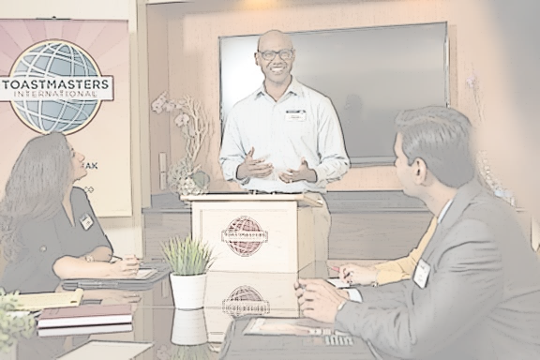
Club Coach Training
(Introduction)
Presented By
Jim Kearney
218F

Slide 2
“Understanding is the first step to acceptance, and only with acceptance can there be recovery..”
- J. K. Rowling

Slide 3
Agenda
▸ Why do we need coaches?
▸ The Club Coach
▸ Coach VS Mentor
▸ Qualifications
▸ A Coach’s Responsibility
▸ Club Coach Program Requirements
▸ Before you Begin
▸ Rebuilding
▸ Defining the Plan
▸ Becoming a Quality Club
▸ Recognition, Recognition, Recognition
▸ Plan for the Future
▸ Summary

Slide 4
Why do we need coaches?
Most Toastmasters clubs experience a life cycle.
A Toastmasters club needs to be rebuilt when, for some reason, its existence is in jeopardy.

Slide 5
The Club Coach
The club coach is a Toastmaster who is not a member of the club and not familiar with the club or its members.
This perspective allows the coach to objectively view the club. The coach is a counselor, a source of knowledge and a fountain of ideas.
To be successful as a coach you will need all your speaking, thinking and listening skills – as well as hard work, determination and patience.

Slide 6
Coach VS Mentor
 | Coach | Mentor
Focus | Performance Improvement | Individual Development
Relationship timeframe | Short term | Long term
Agenda | Set | Open
Orientation | Task related | Relationship related
When to use | Improve specific performance | Career growth and development

Slide 7
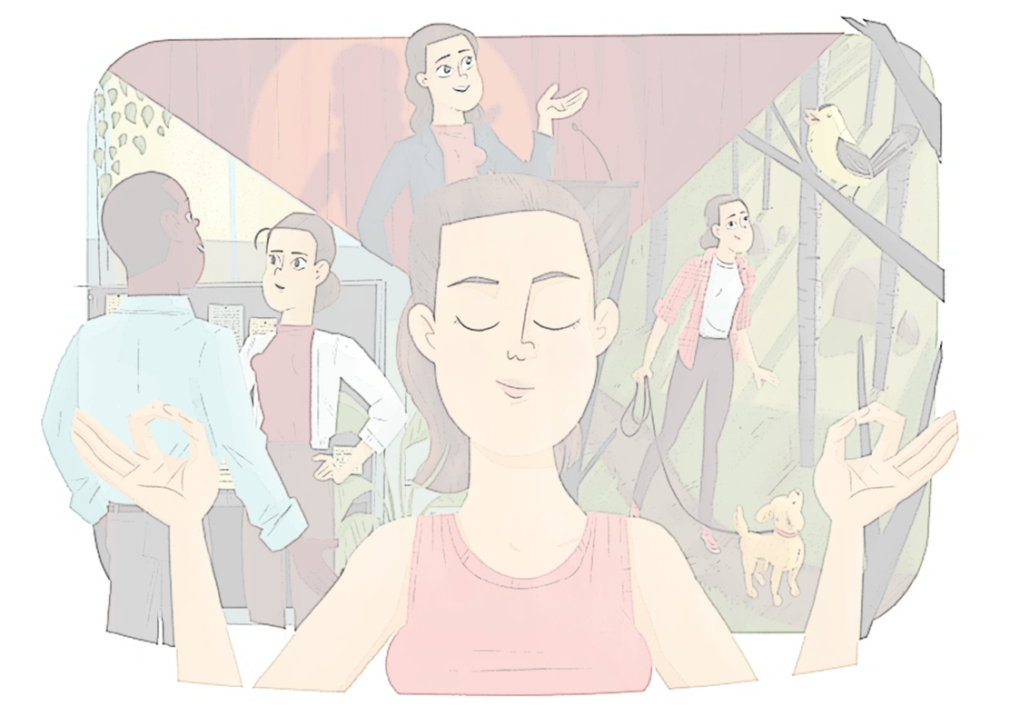
Club Coach Qualifications
A Toastmaster who is not a member of the struggling club upon appointment.
This perspective allows the coach to objectively view the club
The coach is a counselor, a source of knowledge and a fountain of ideas

Slide 8
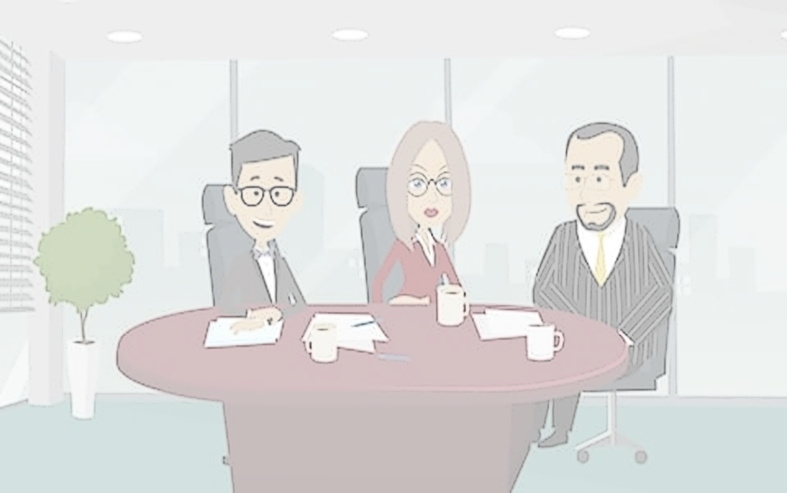
Club Qualifications
Fewer than 12 paid members
Coach is not a member of the club when appointed
Club Wants a Coach
Coach is appointed by the DD or CGD

Slide 9
A Coach’s Responsibility
Builds a rapport
Observes and analyzes the club environment
Helps the club develop goals
Enables the club to achieve goals
Instills enthusiasm, fidelity, and a sense of responsibility

Slide 10
A Coach’s Responsibility
Sets high but achievable expectations
Guides team members
Offers support
Gives advice
Provides feedback
Encourages team members

Slide 11
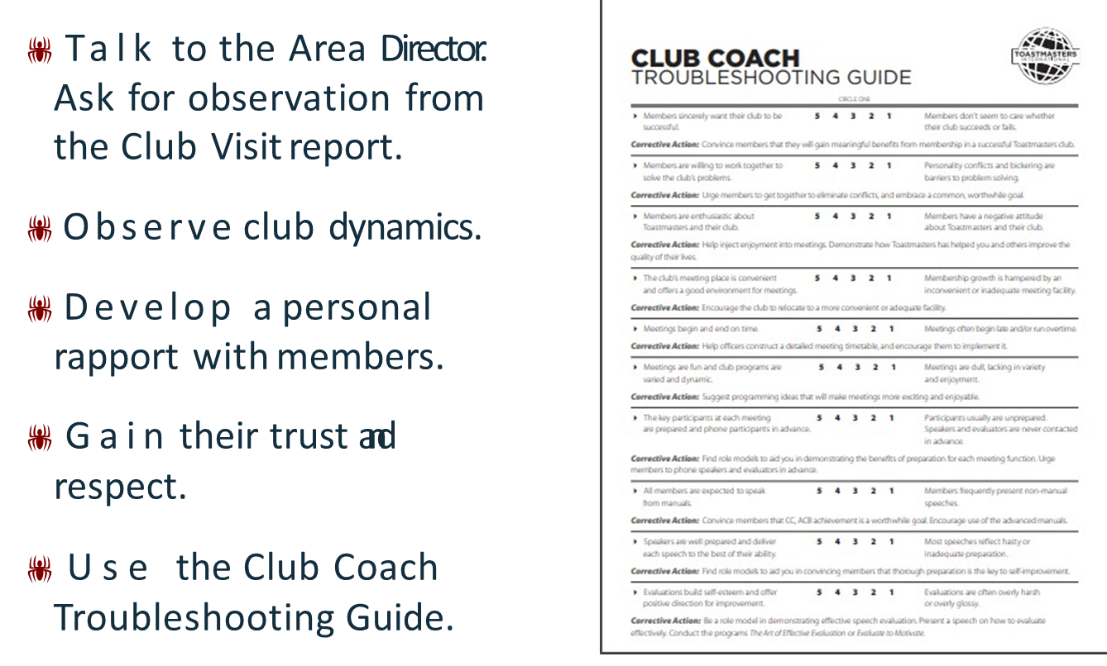
The First Steps

Slide 12
The Rebuilding Process
Foster a sense of ownership.
Emphasize teamwork.
Let them know that you are there to help them.
Encourage clubs to use other clubs as models.
Support the addition of their own unique style.
Have the club conduct
Moments of Truth.

Slide 13
Defining The Plan
Internal Actions
External Actions
Meeting time, place, and location
Club meeting programming
Meeting participants
Guests
Officer preparedness
Distinguished Club Program
Encourage and recognize accomplishment
Attracting new members
Membership programs
Public relations

Slide 14
Becoming a Quality Club
Quality clubs have a member service perspective.
The club’s criteria for service reflect quality and reliability.
It takes 20 members to support a club
Combat attrition with a membership building culture
Run club membership contests
Formally recognize members achieving any educational awards
Mention achievements in club newsletters and on their website/social media.

Slide 15
Recognition, Recognition, Recognition
 Formally recognize members achieving any education award
 Mention achievements in club newsletters and on their website.
Emphasize the importance of recognizing members.
Encourage corporate clubs to use the company email, intranet, and newsletter to recognize members.
Publicize the club’s achievement in the Distinguished Club Program.

Slide 16
Plan For The Future
A vision is what members want their club to become.
Help members develop a vision for the club.
Get their agreement to fulfill the club mission.
Guide the club to set specific goals.

Slide 17
Club Rescue Summary
Agreement
Diagnose
Use Club Troubleshooting Guide
Action Plan
Follow up
Meet with Club Leaders for 1:1.
Get appointed as Club Coach.
Create Club Success Plan
Meet with Club Officers and introduce yourself as the Club Coach
Conduct Moments of Truth
Membership Building Program
Support new club culture
Recognition

Slide 18
“Where we meet resistance, we must use only the force that is necessary and no more.”
- Albus Dumbledore

Slide 19
Resources
▸ Club Coach Troubleshooting Guide
https://www.toastmasters.org/resources/club-coach-troubleshooting-guide
▸ First Class Club Coach. Item 218F
https://www.toastmasters.org/resources/first-class-club-coach
▸ How to Rebuild a Toastmasters Club. Item 1158
https://www.toastmasters.org/resources/how-to-rebuild-a-toastmasters-club
▸ The Leader as a Coach. Item 318A
https://www.toastmasters.org/resources/the-leader-as-a-coach

